Slide 1
Salads Harvesting Services Ltd
Welcome

Slide 2
Contracts & Working Hours
Contracts:
Temporary Student Engineering Operative contracts
Working Hours:
48-55 working hrs per week
Pay rate:
£7.50 per hour (from Apr 2018 will be £7.90)
£9.38 overtime (applicable after 40 hrs)

Slide 3
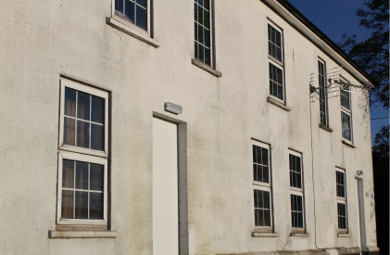
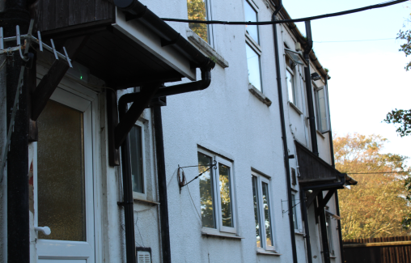
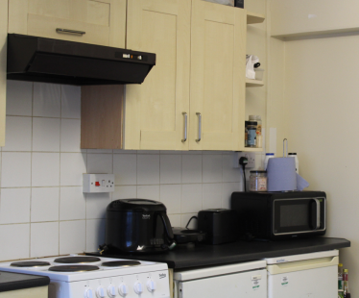
Accommodation
Shared accommodation
£56.85 per week

Slide 4
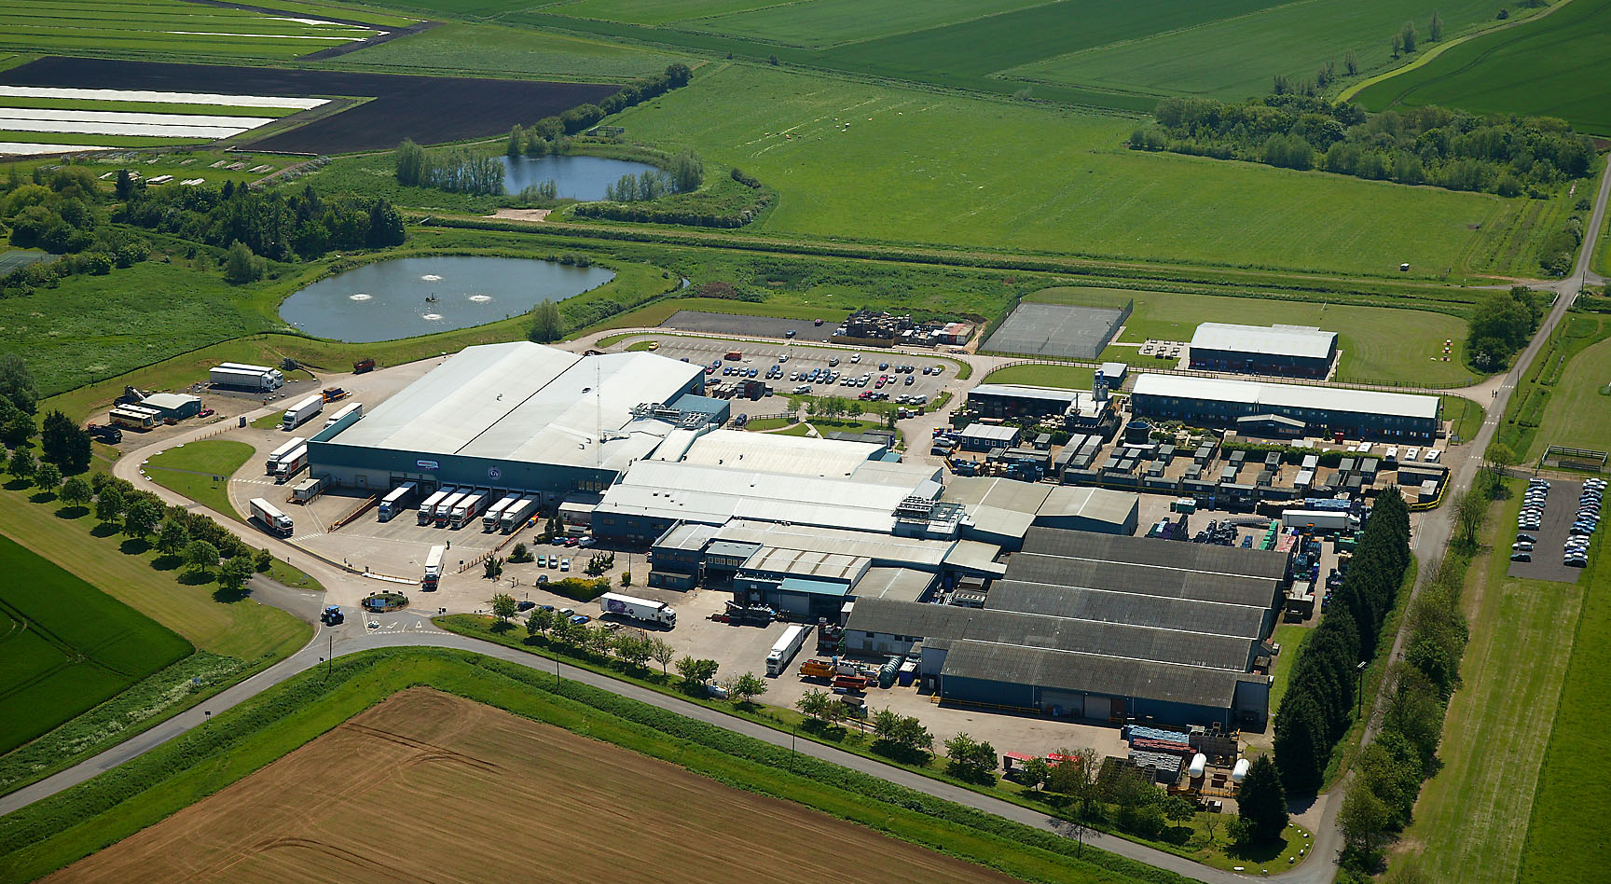
Facilities: UK
Barway
Marketing, Production, Distribution, Administration, Hostel
Trust | Efficiency | Quality | Expertise | Can do

Slide 5
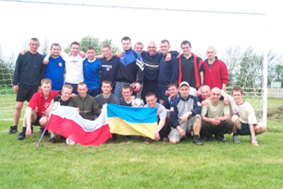
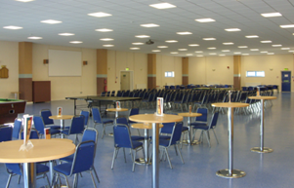
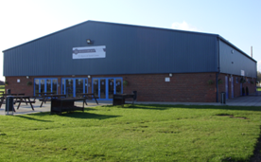
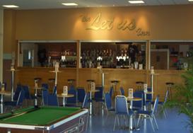
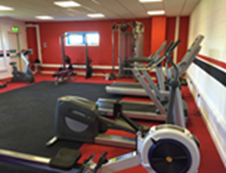
Facilities
5 miles radius – G’s Social & Sports Centre
Disco nights every weekend
Summer parties
Gym
Access to local supermarkets

Slide 6
Literacy & Numeracy requirements
The students would be required to have the above minimum Literacy & Numeracy

Slide 7
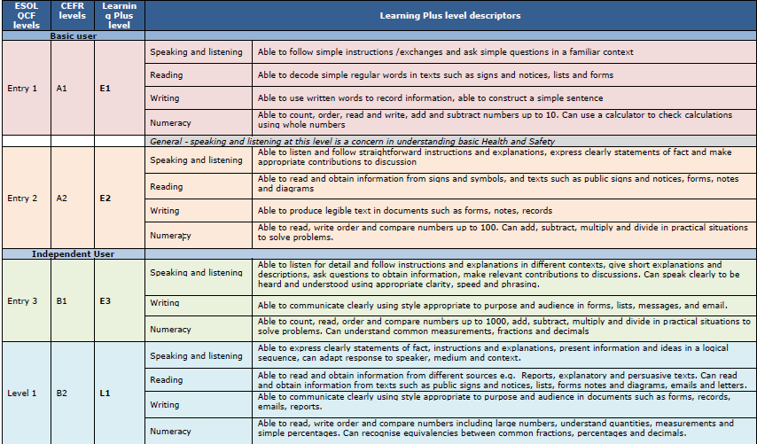
Literacy & Numeracy levels explained

Slide 8
Students tasks and learnings
- Lock off and isolation
- Safe Working Procedures
- Preventative Maintenance
- Reactive Maintenance
- Stock control and its importance
- Welding Preparation, Welding test pieces, Inspection of test pieces, Welding equipment/Rigs
Cutting and metal preparation
Protection and life extension of metals (Painting)
Engine maintenance, Oil and filter change, Component inspection, specification testing
(compression testing)
Hydraulic and pneumatic system inspection and testing
Electrical wiring inspection for damage and corrosion
Electrical drawing (depending on student)

Slide 9
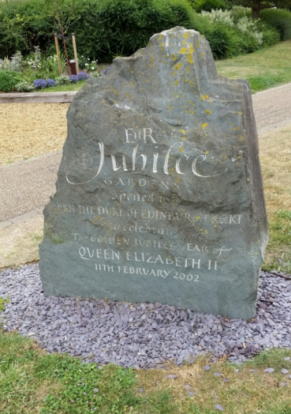
Near by
Ely train station – 5 min drive from the Workshop
Cambridge - 17 min by train
London – 1 hrs by train
Places to visit in Ely:
Ely Cathedral
The Stained Glass Museum
Nightlife: bars & pubs

Slide 10
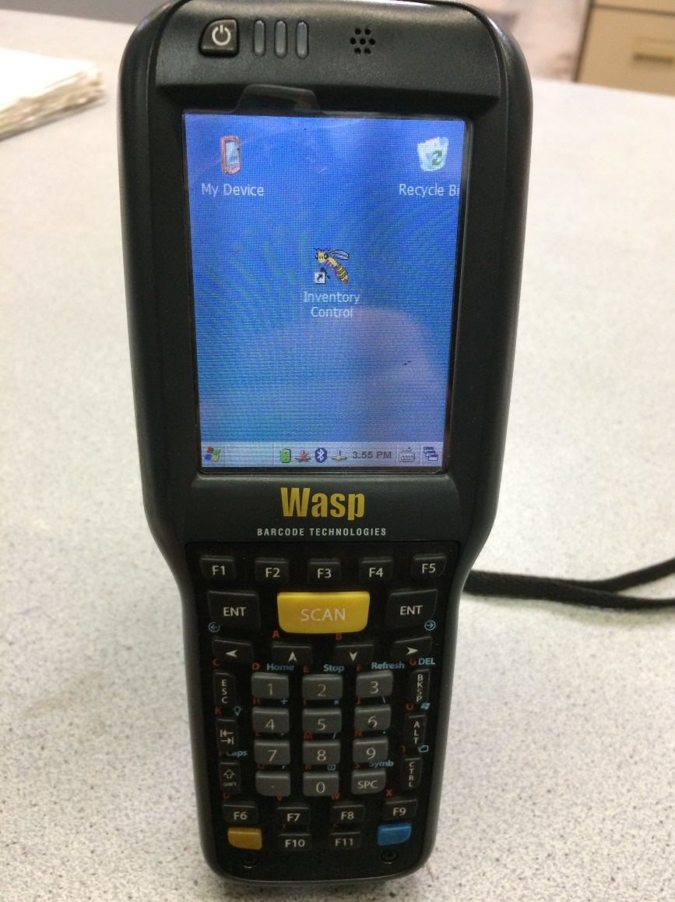
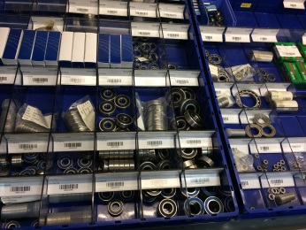
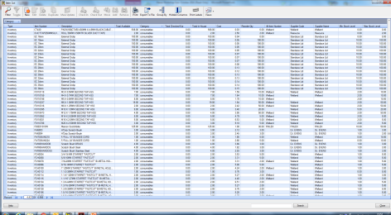
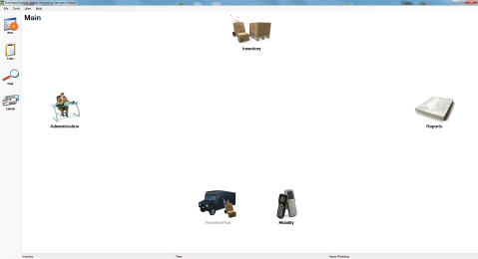
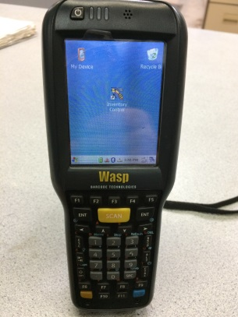
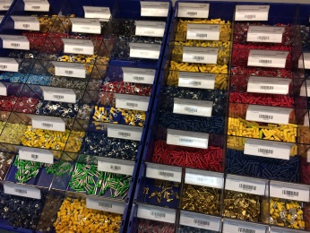
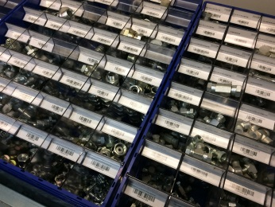
Hasse Workshop stock control system
G’s is committed to equality and encouraging diversity amongst our workforce
Our aim is that our workforce will be truly representative of all sections of society and each worker will feel respected and able to give of their best

Slide 11
Equal Opportunities Statement
G’s is committed to equality and encouraging diversity amongst our workforce
Our aim is that our workforce will be truly representative of all sections of society and each worker will feel respected and able to give of their best

Slide 12
Ethical Trading Initiative

Slide 13
HR Team & Contact Details
Ramona Both – Senior HR Officer
01353 727418
ramona.both@gs-fresh.com
Petar Kabasakalov – Store Leader
01353 727556
petar.kabasakalov@gs-fresh.com
Phillip Neal – Maintenance Manager
01353 727599
phillip.neal@gs-fresh.com

